Slide 1

Template Method Pattern
Name : Ali Barghouth

Slide 2
Encapsulation
We encapsulated object creation, method invocation, complex interfaces
now encapsulating algorithms

Slide 3
Code Analysis
Two methods are exactly the same
we got code duplicate
which means we can put this common code in a base class

Slide 4
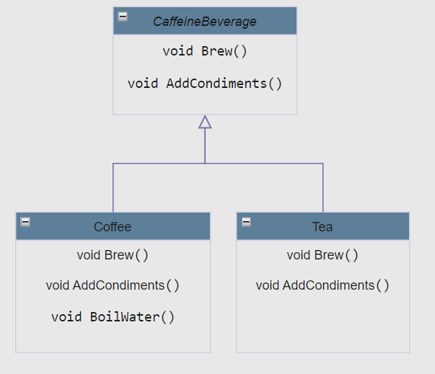
Redesign
base class
the base class contains the common methods
each subclass add its own specific methods

Slide 5
Subclasses
Subclasses extending the interface
rely on the PrepareRecipe method
implement abstract methods
each subclass has its own implementation

Slide 6
Advantage of Using Template Method
One class that contains the template method which controls the algorithm
protected, defined as final
Reduce code duplicate among subclasses
One place that contains the algorithm, any change will be handled there
Template method contains the knowledge (algorithm), steps involved, order of these steps, some concrete implementation of how to do steps can be left to subclasses

Slide 7
Hook method
Subclasses are free to override it but they don’t have to
This gives subclasses the ability to hook into the algorithm

Slide 8
Difference between abstract method & hook method
abstract method is used when the subclass MUST provide an implementation
hook method is optional
can be used to implement an optional part of the algorithm
can be skipped if it is not important to the subclass

Slide 9
Summary
Template method defines the structure of an algorithm
Helps in reusing the code
Control the steps involved in the algorithm
can defer implementation of some steps to subclasses
Abstract class containing the template method, defines steps as
abstract methods
concrete methods
hook methods
Superclass relies on subclass, but call them when needed
this is the Hollywood principle
high-level component decides when & how to call low-level components

Slide 10
Real Example on Template Method
The payment system has a payment gateway which is a template method.
The customer can use the payment gateway to make a payment.
The payment gateway has a few steps that are defined in the template method - validating the payment, transferring the money and updating the database.
However, the implementation of these steps is decided by the exact payment option that the customer chooses - Credit Card, Net Banking, PayPal, etc.

